Slide 1
MARKETING PVT LTD
(Advanced Distribution Management System)
WELCOMES YOU
...SMART BIKE FOR SMART CITIZENS...
www.admsebikes.in

Slide 2
KNOW US
THE STORY OF ADMS BEGAN ON SEPTEMBER 2020 WITH A VISION OF PARTICIPATING IN INDIA’S NEXT WAVE OF GROWTH IN THE ELECTRIC VEHICLE INDUSTRY.
A STORY THAT HAS NOW UNFOLDED AND GROWN WITH THE ACTIVE SUPPORT OF OUR DEDICATED TEAM OF DIRECTORS, EMPLOYEES, DEALERS & A POWER FULL FORCE OF MARKETING DISTRIBUTORS
WE BEGAN WITH JUST TWO MODELS IN 2020 AND NOW WE HAVE INTRODUCED
18 MODELS OF ELECTRIC-TWO WEELERS , 2 MODELS OF ELECTRIC-LOADERS & ARE IN PROCESS OF INTRODUCING ELECTRIC-PASSENGER AUTOS, ELECTRIC-TRACTORS & ELECTRIC-CARS.

Slide 3
Meet Our Expert Team
ASHOK TANGADI
MAHESH GONDHLI
MANAGING DIRECTOR
/ CHAIRMAN
C.E.O
B PHARMA
"You need to be aware of what others are doing, applaud their efforts, acknowledge their successes, and encourage them in their pursuits. When we all help one another, everybody wins."
B COM/MBA
DILAVAR MALLADE
SHAHEEN SAYED
MARKETING DIRECTOR
VICE PRESIDENT
/CREATIVE DIRECTOR
electrical engineer
MBA

Slide 4
INDIA’S FASTEST GROWING COMPANY IN
THE ELECTRIC TRANSPORT SEGMENT
E-BIKES
E-SPORTS BIKES
E-AUTO
&
ADMS E-PAY
RIDE THE FUTURE WAVE WITH US

Slide 5
OUR UPCOMING SEGMENT
E-TRACTOR
THERE ARE A VARIETY OF TRACTORS AVAILABLE WITH DIFFERENT HORSEPOWER LEVELS AND TORQUE. THE E TRACTOR 18HP, 35HP & 70HP IS EQUIPPED WITH HIGH SPEED SOLAR SHED CHARGING AND MAXIMUM BACKUP TO PROTECT
E-CAR
THE E CAR HIGH SPEED CHARGER IS DESIGNED TO PROVIDE FAST CHARGING FOR ELECTRIC VEHICLES. IT HAS A MAXIMUM TOP SPEED AND RANGE, WHICH ALLOWS DRIVERS TO TRAVEL LONG DISTANCES WITHOUT HAVING TO STOP FOR RECHARGE.

Slide 6
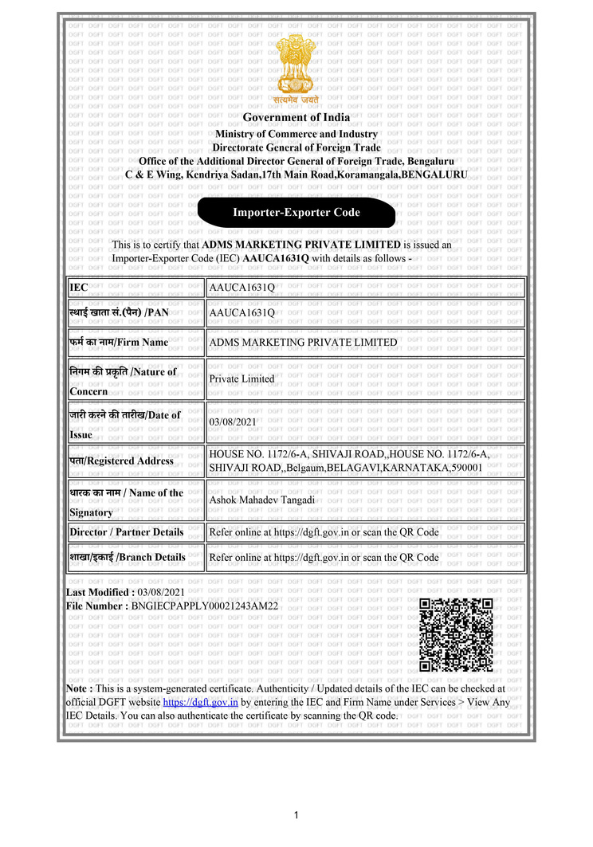
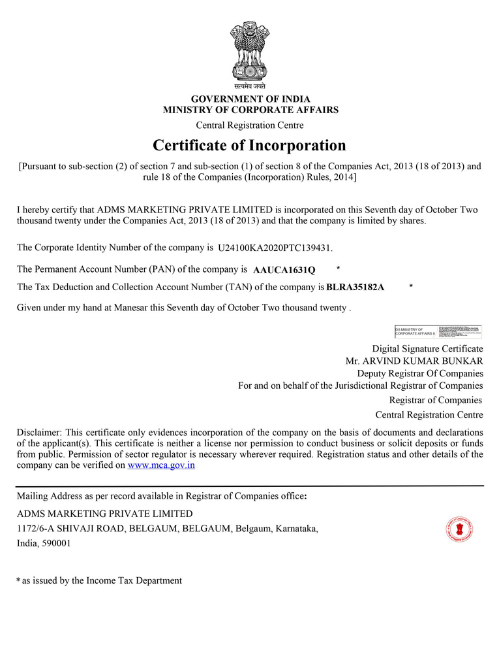
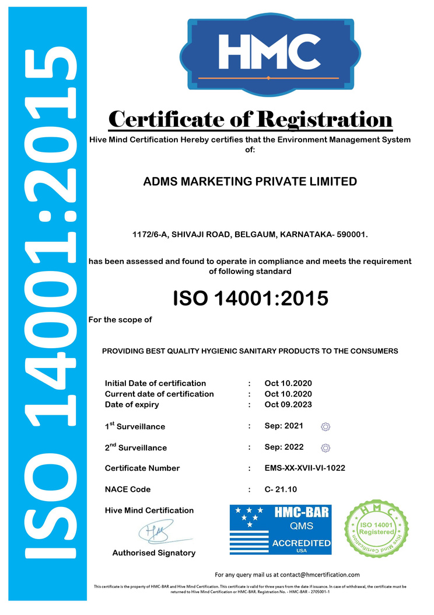
LEGALITY

Slide 7
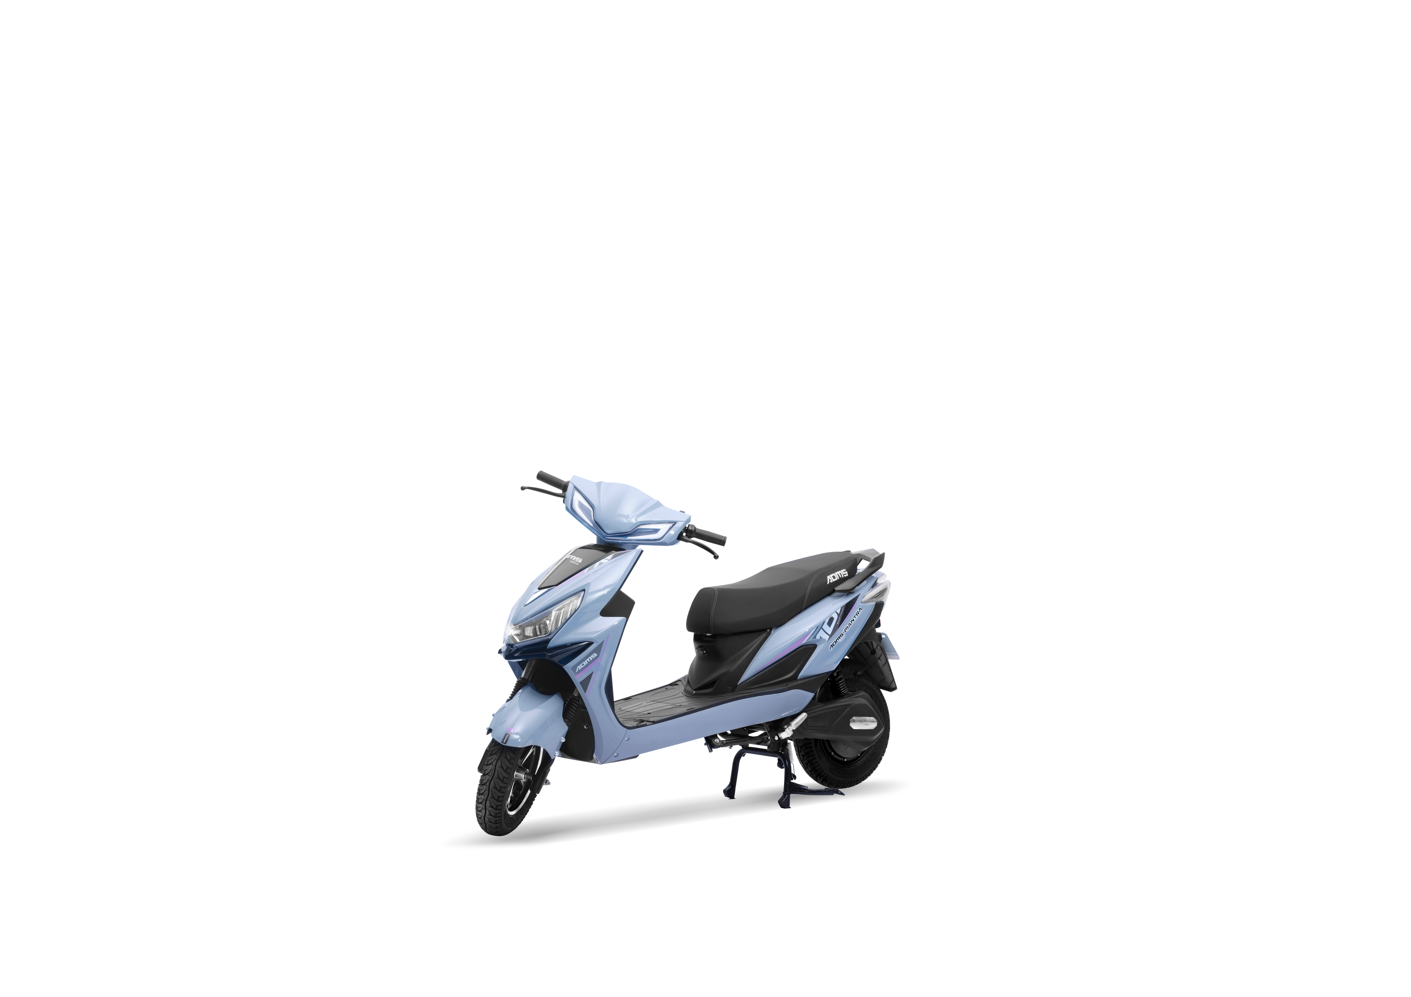
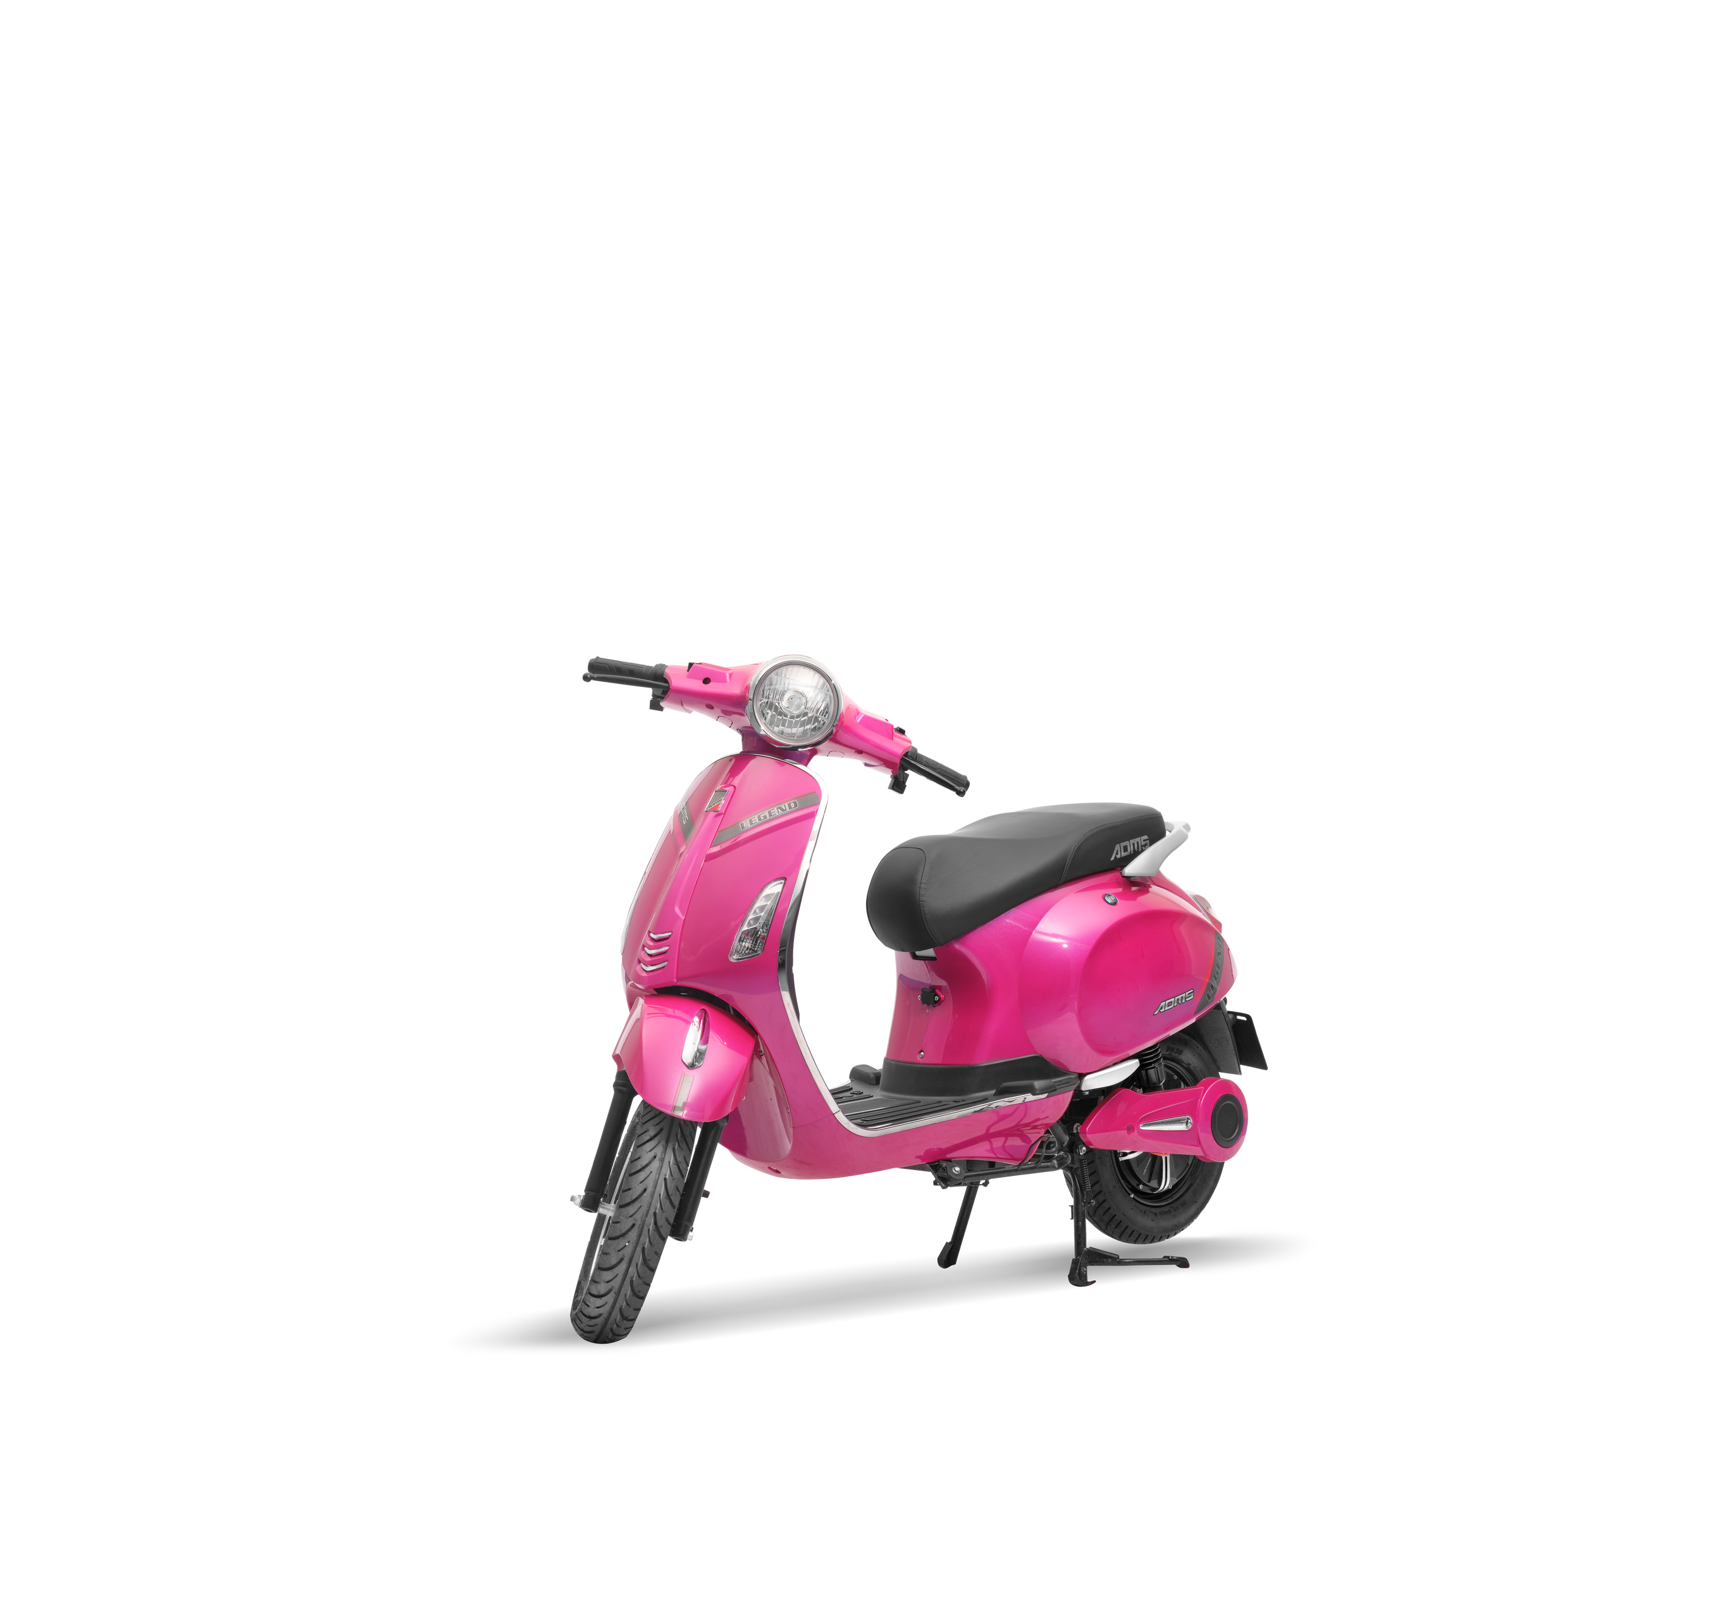
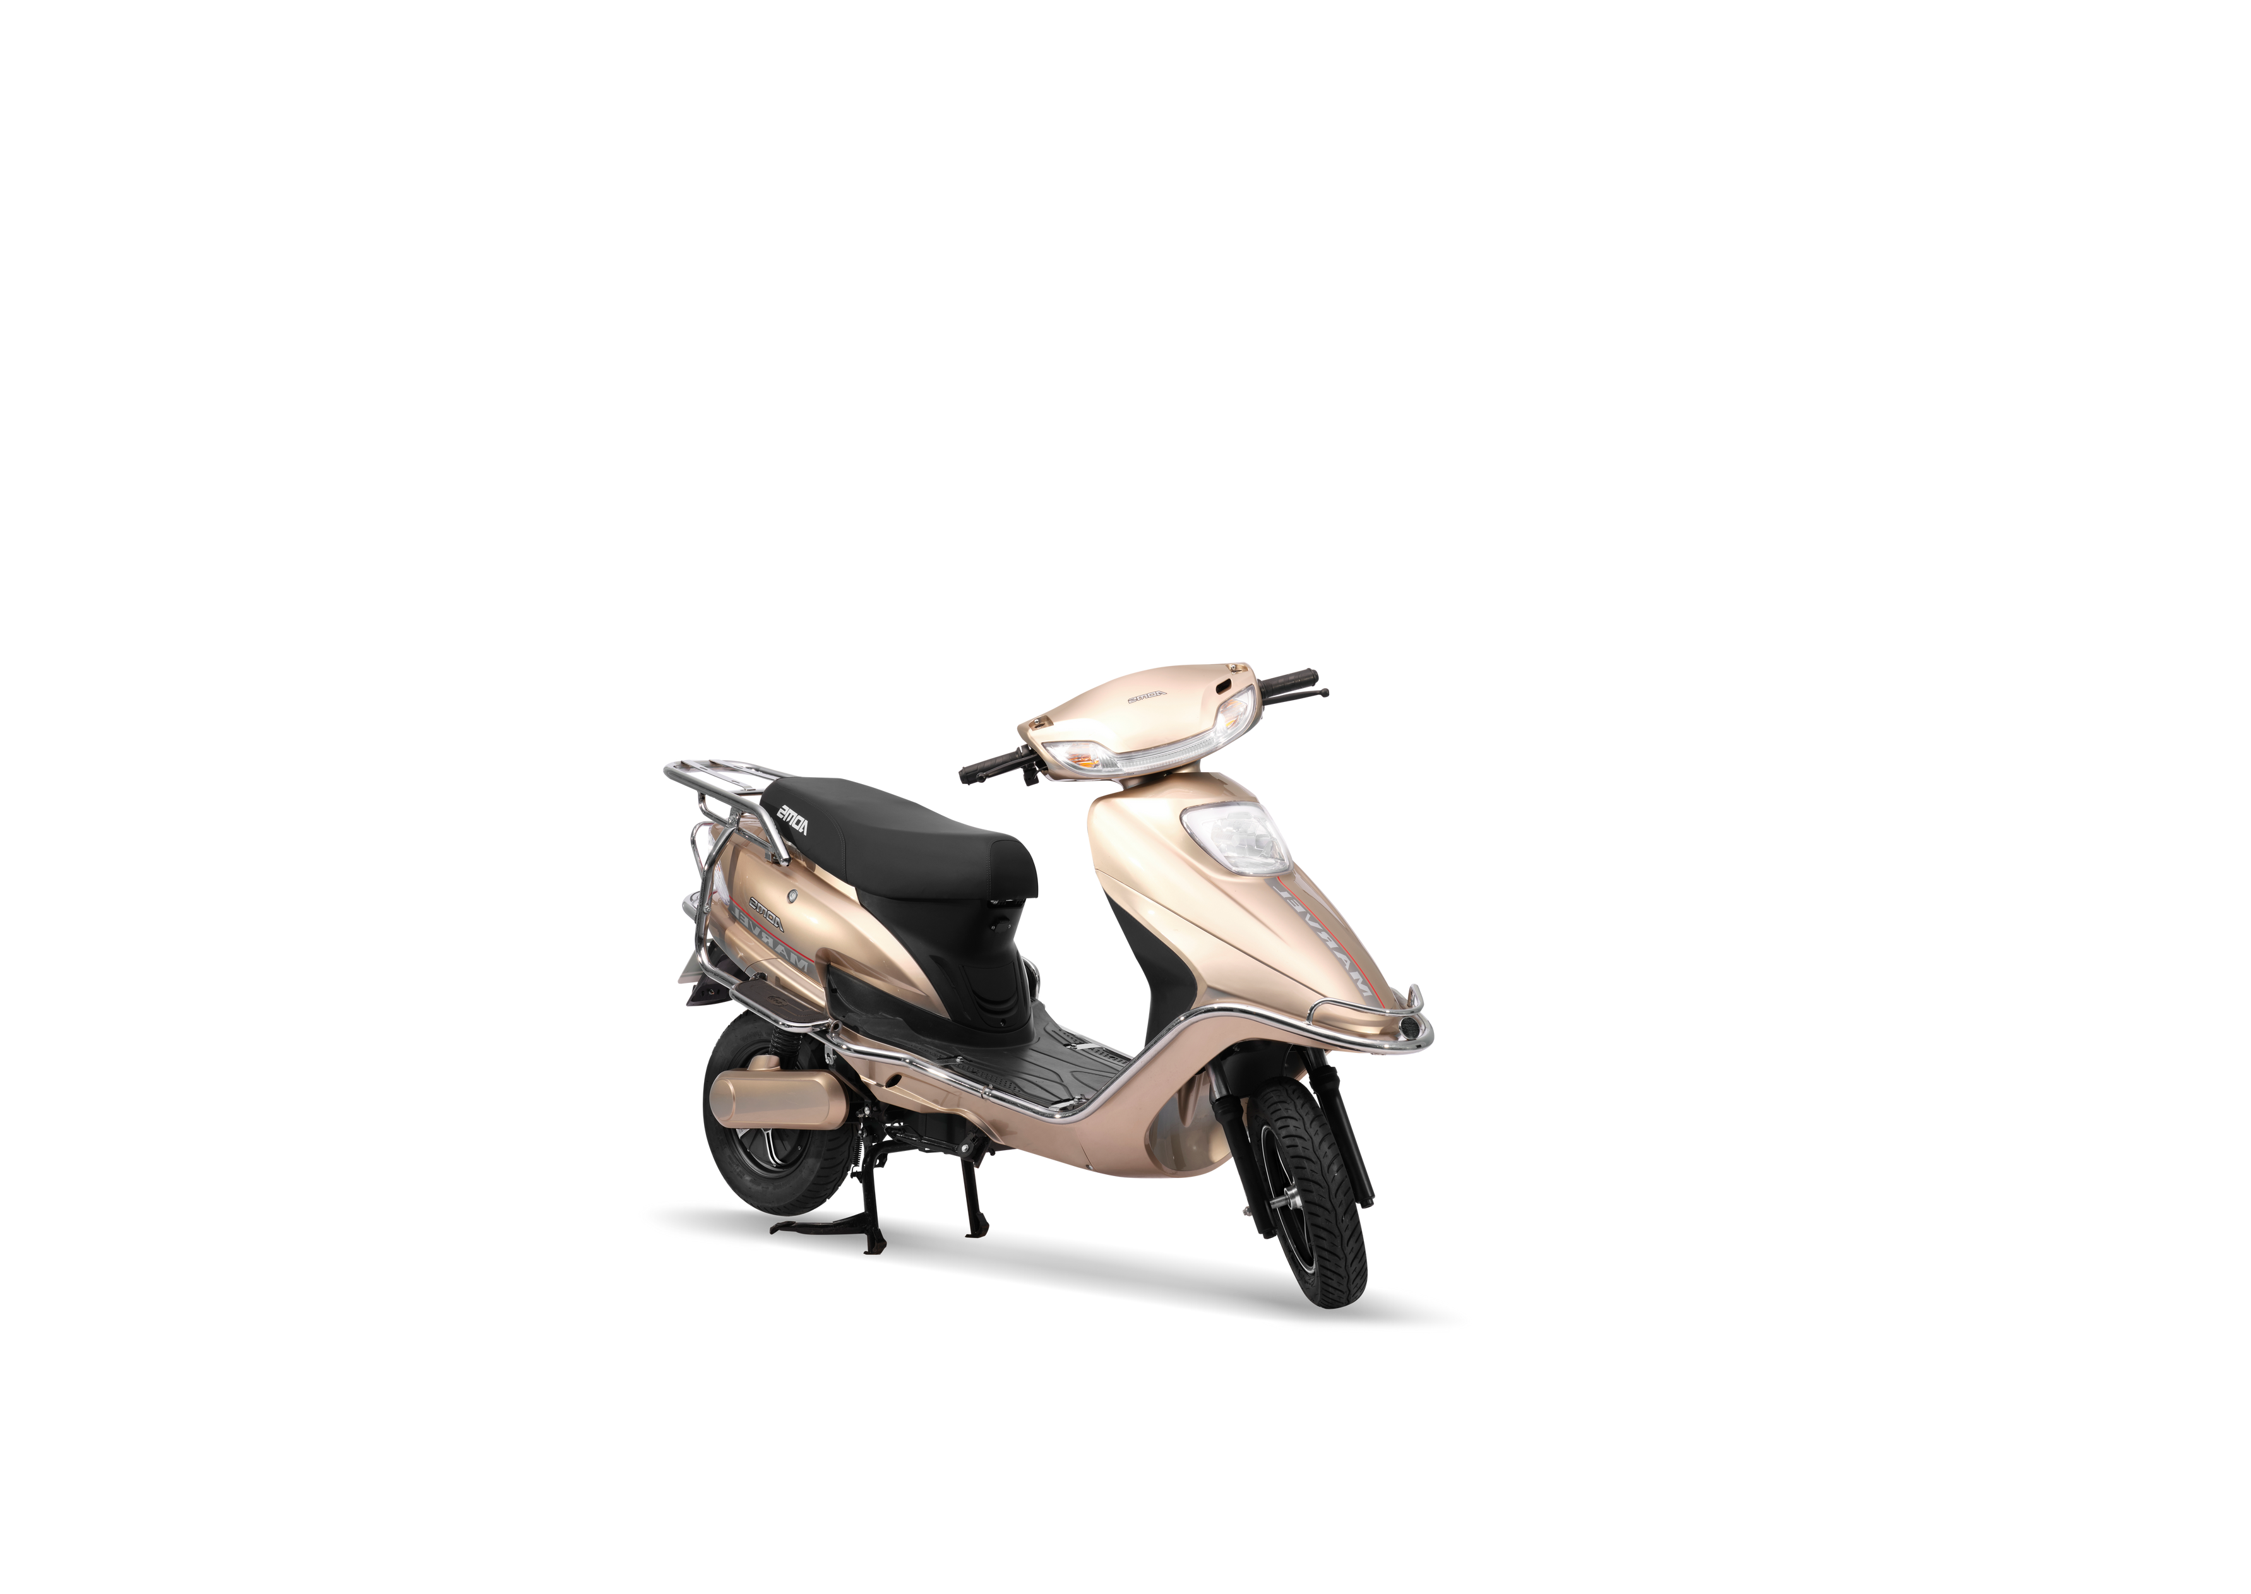
NON REGISTERED VEHICLES
LEGEND
MAEVEL
MANTRA
₹97,000/-
₹97,000/-
RATED POWER: 250 W
PEAK POWER: 1000 W
RANGE/CHARGE: 70/100KMS
BATTERY: 48V 26AH/60V 36AH
LOADING CAPACITY: 150KG
RATED POWER: 250 W
PEAK POWER: 1000 W
RANGE/CHARGE: 60/100KMS
BATTERY: 48V 26AH/60V 36AH
LOADING CAPACITY: 180KG
₹98,000/-
RATED POWER: 250 W
PEAK POWER: 1000 W
RANGE/CHARGE: 60/100KMS
BATTERY: 48V 26AH/60V 36AH/60V 7AH
LOADING CAPACITY: 180KG
*PRICE DEPENDS UPON MARKET INFLATION

Slide 8
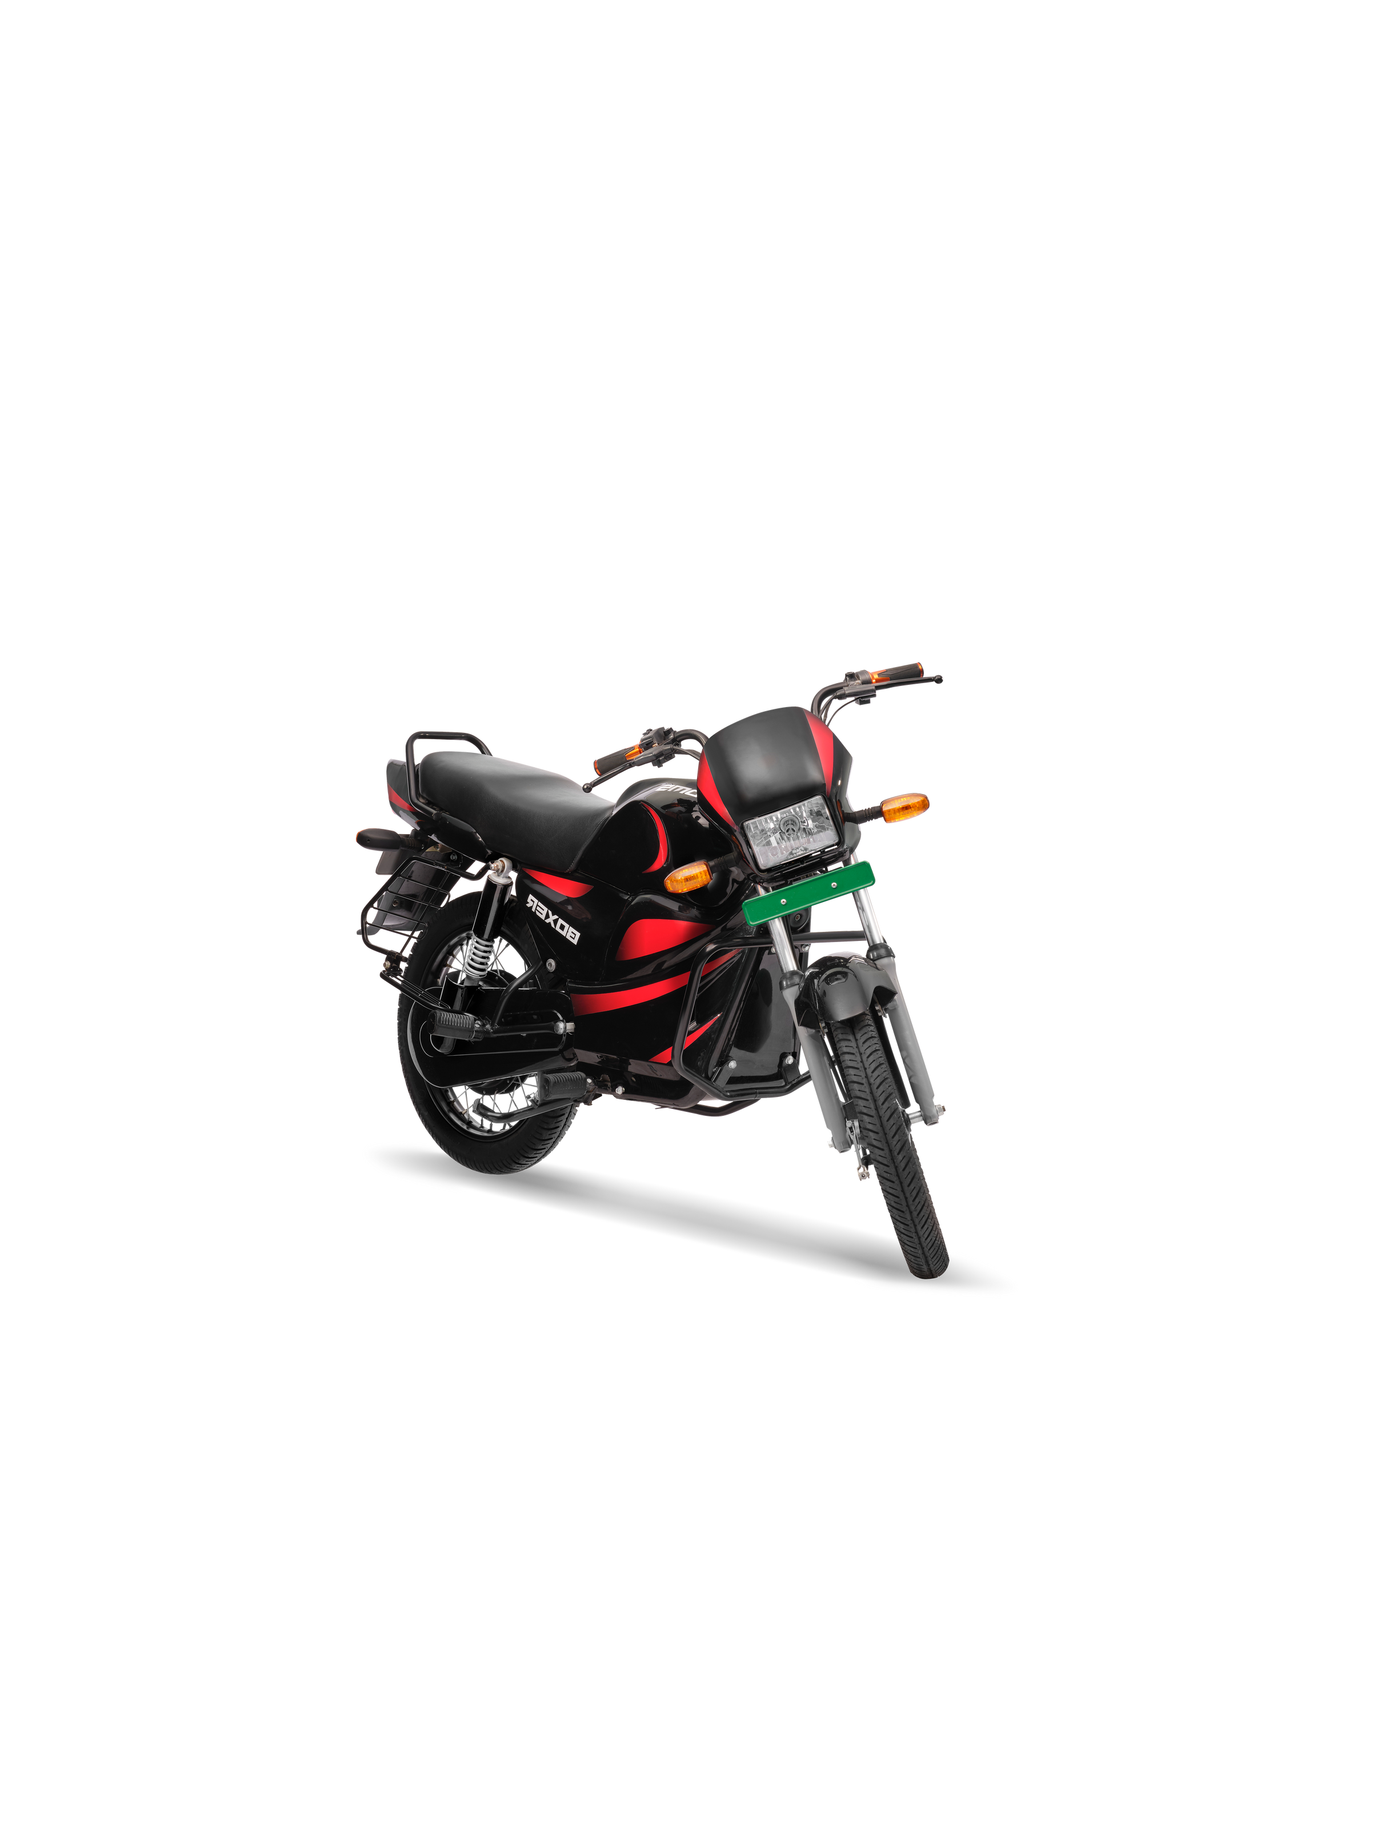
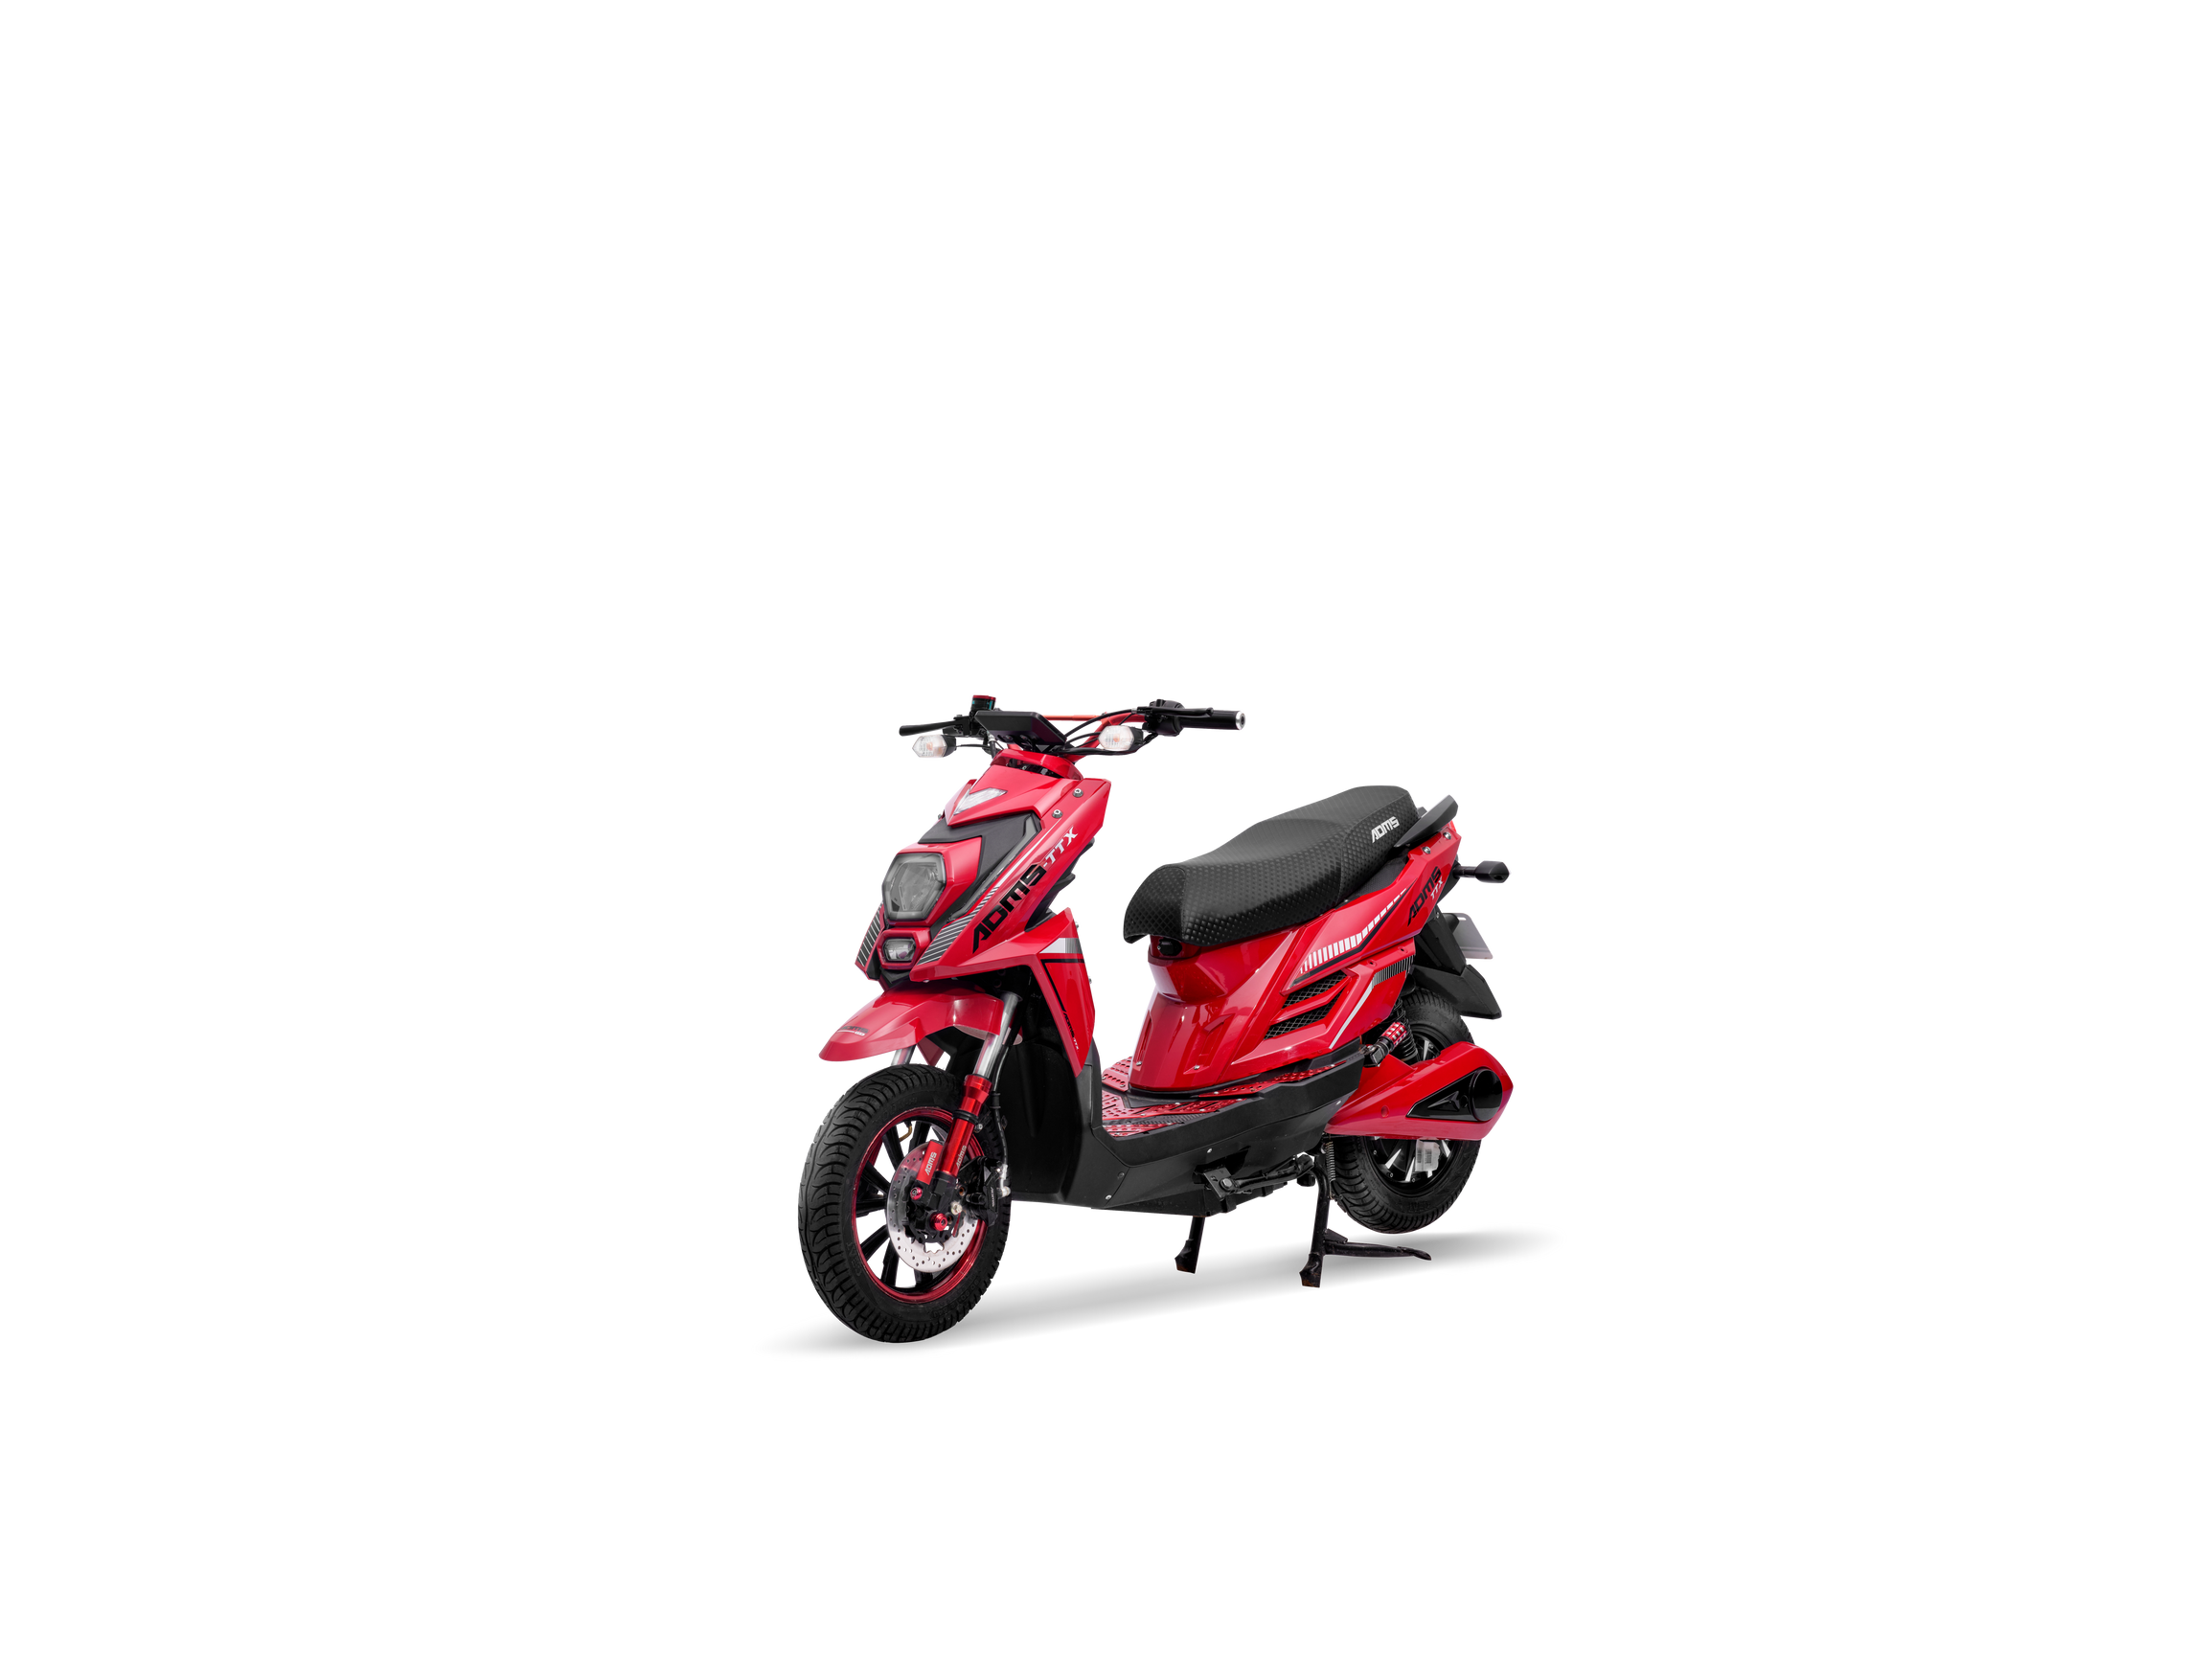
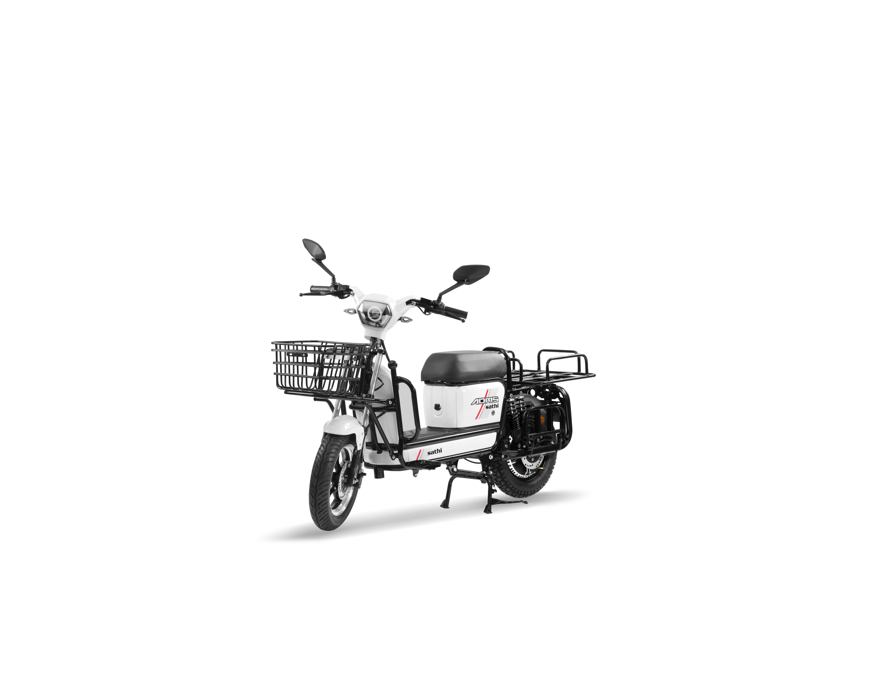
NON REGISTERED VEHICLES
T T X
BOXER
SATHI
₹1,25,000/-
₹1,15,000/-
RATED POWER: 1200 W
PEAK POWER: 2500 W
RANGE/CHARGE: 100/150KMS
BATTERY: 52.2V 42AH/52.2V 52AH
LOADING CAPACITY: 180KG
RATED POWER: 250 W
PEAK POWER: 1500 W
RANGE/CHARGE: 100/200KMS
BATTERY: 60V 36AH/60V 72AH
LOADING CAPACITY: 200KG
₹99,000/-
RATED POWER: 250 W
PEAK POWER: 1200 W
RANGE/CHARGE: 80/100KMS
BATTERY: 60V 26AH/60V 36AH
LOADING CAPACITY: 250KG
*PRICE DEPENDS UPON MARKET INFLATION

Slide 9
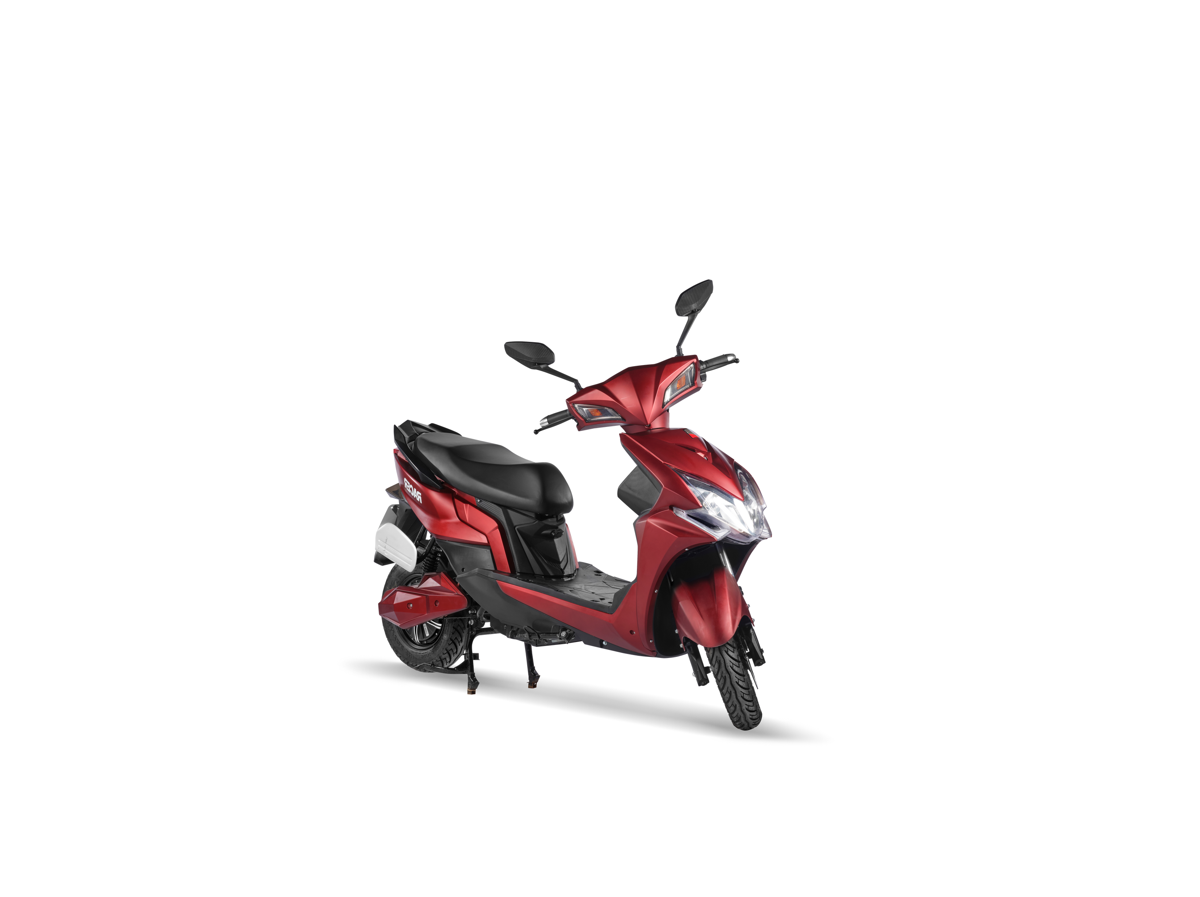
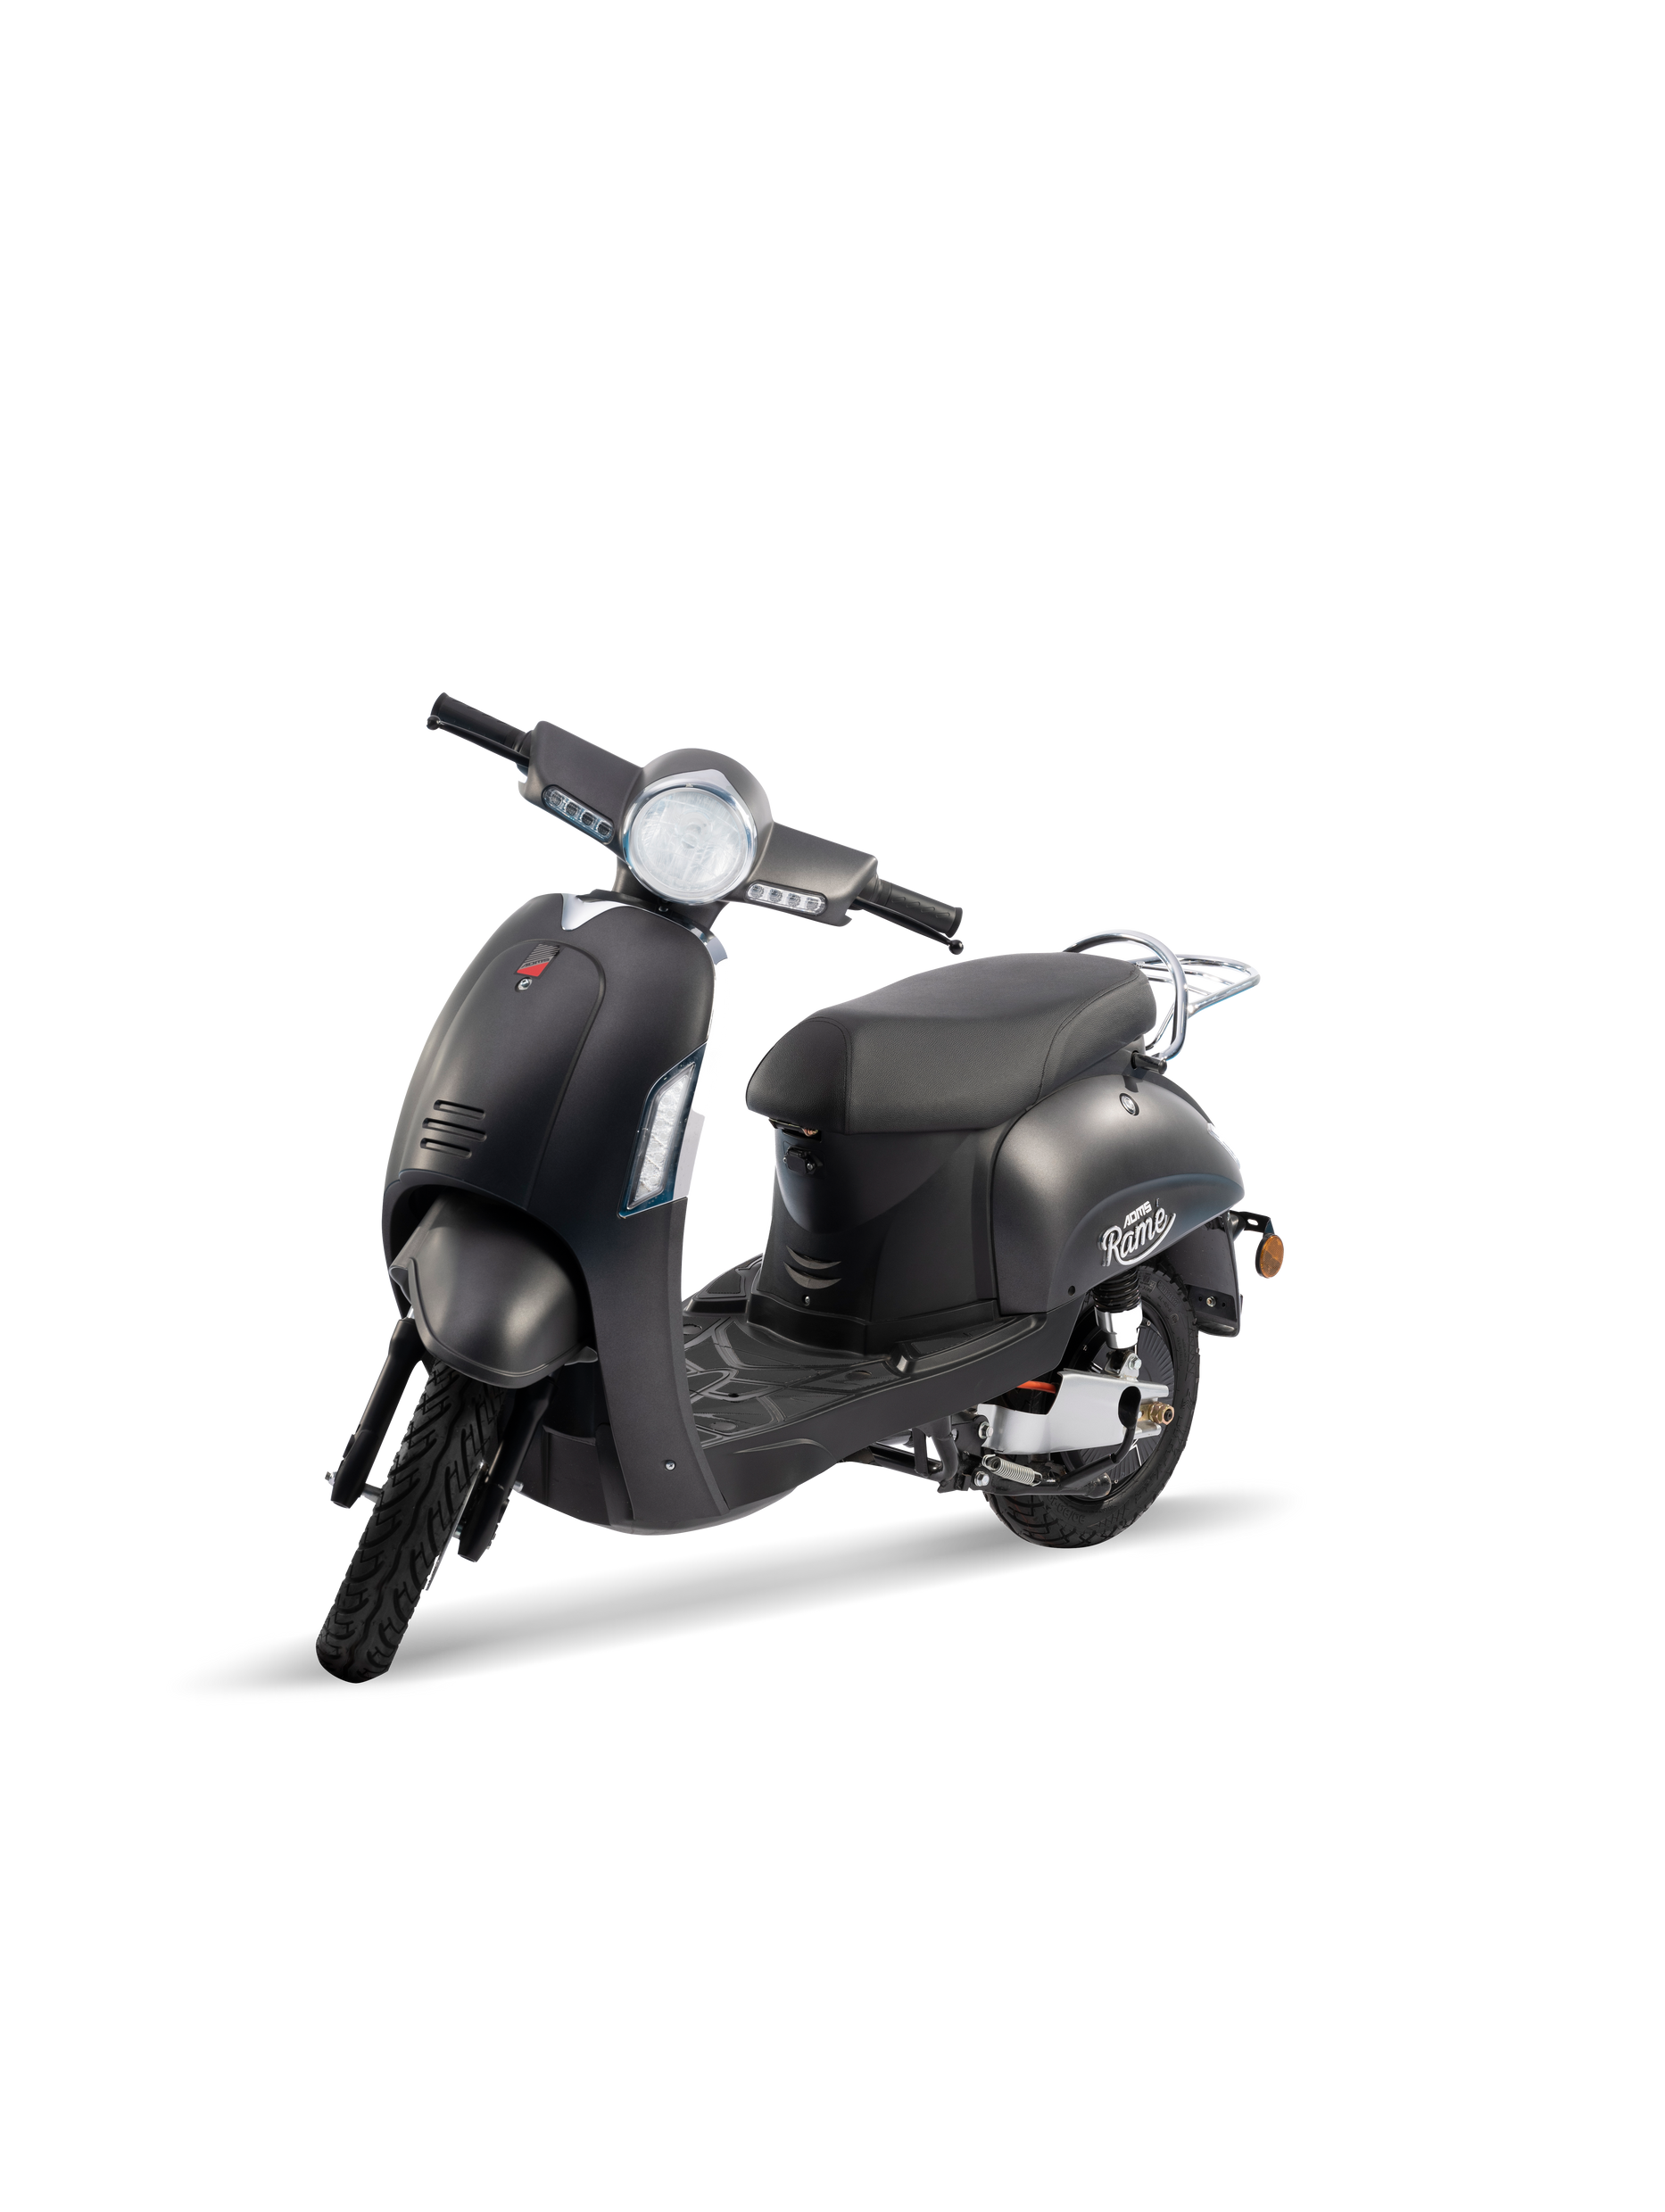
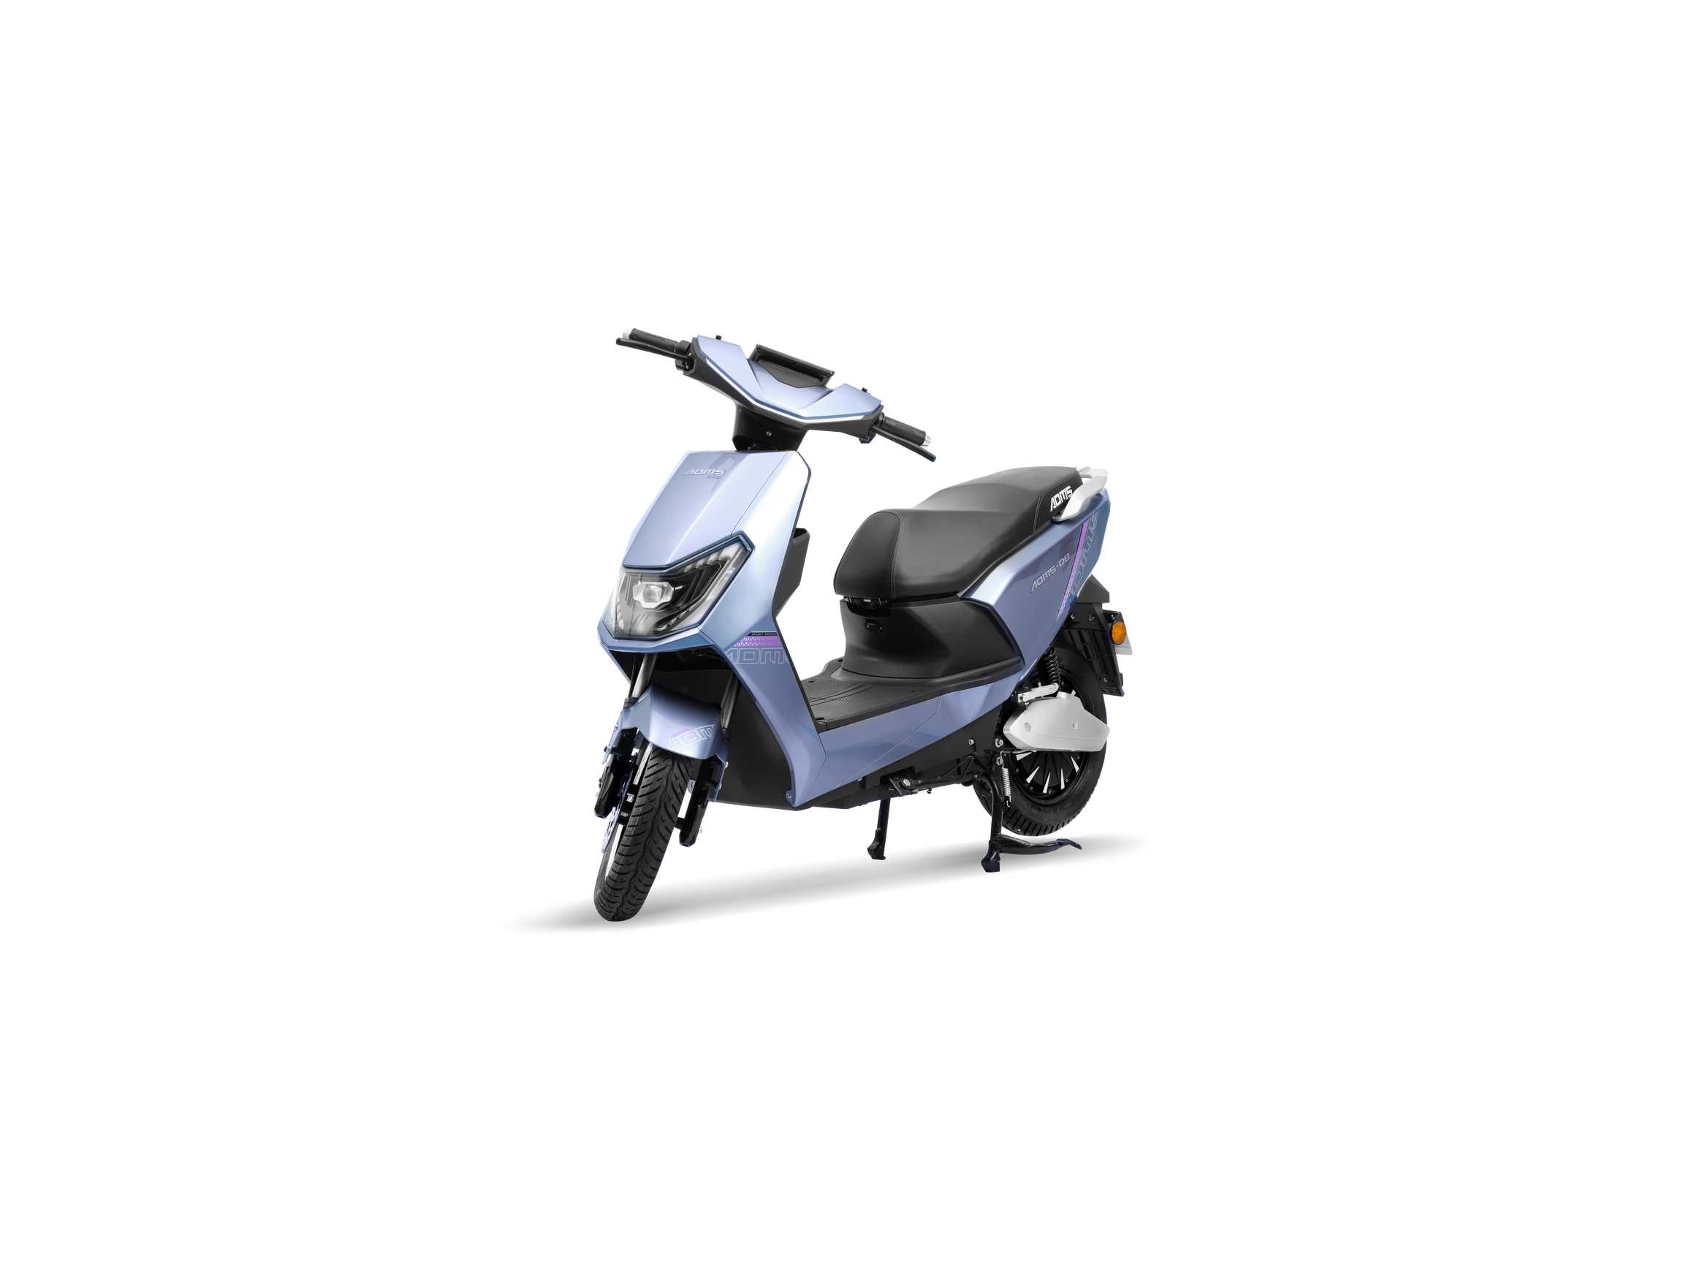
REGISTERED VEHICLES
RAME
RACER
D B
₹1,10,000/-
₹1,25,000/-
RATED POWER: 1200 W
PEAK POWER: 2500 W
RANGE/CHARGE: 100/150KMS
BATTERY: 60V 36AH/60V 72AH
LOADING CAPACITY: 180KG
RATED POWER: 2000 W
PEAK POWER: 4000 W
RANGE/CHARGE: 100KMS
BATTERY: 60V 36AH
LOADING CAPACITY: 180KG
₹1,33,000/-
RATED POWER: 1200 W
PEAK POWER: 3000 W
RANGE/CHARGE: 80/100/150KMS
BATTERY: 60V 36AH/60V 50AH
LOADING CAPACITY: 180KG
*PRICE DEPENDS UPON MARKET INFLATION

Slide 10
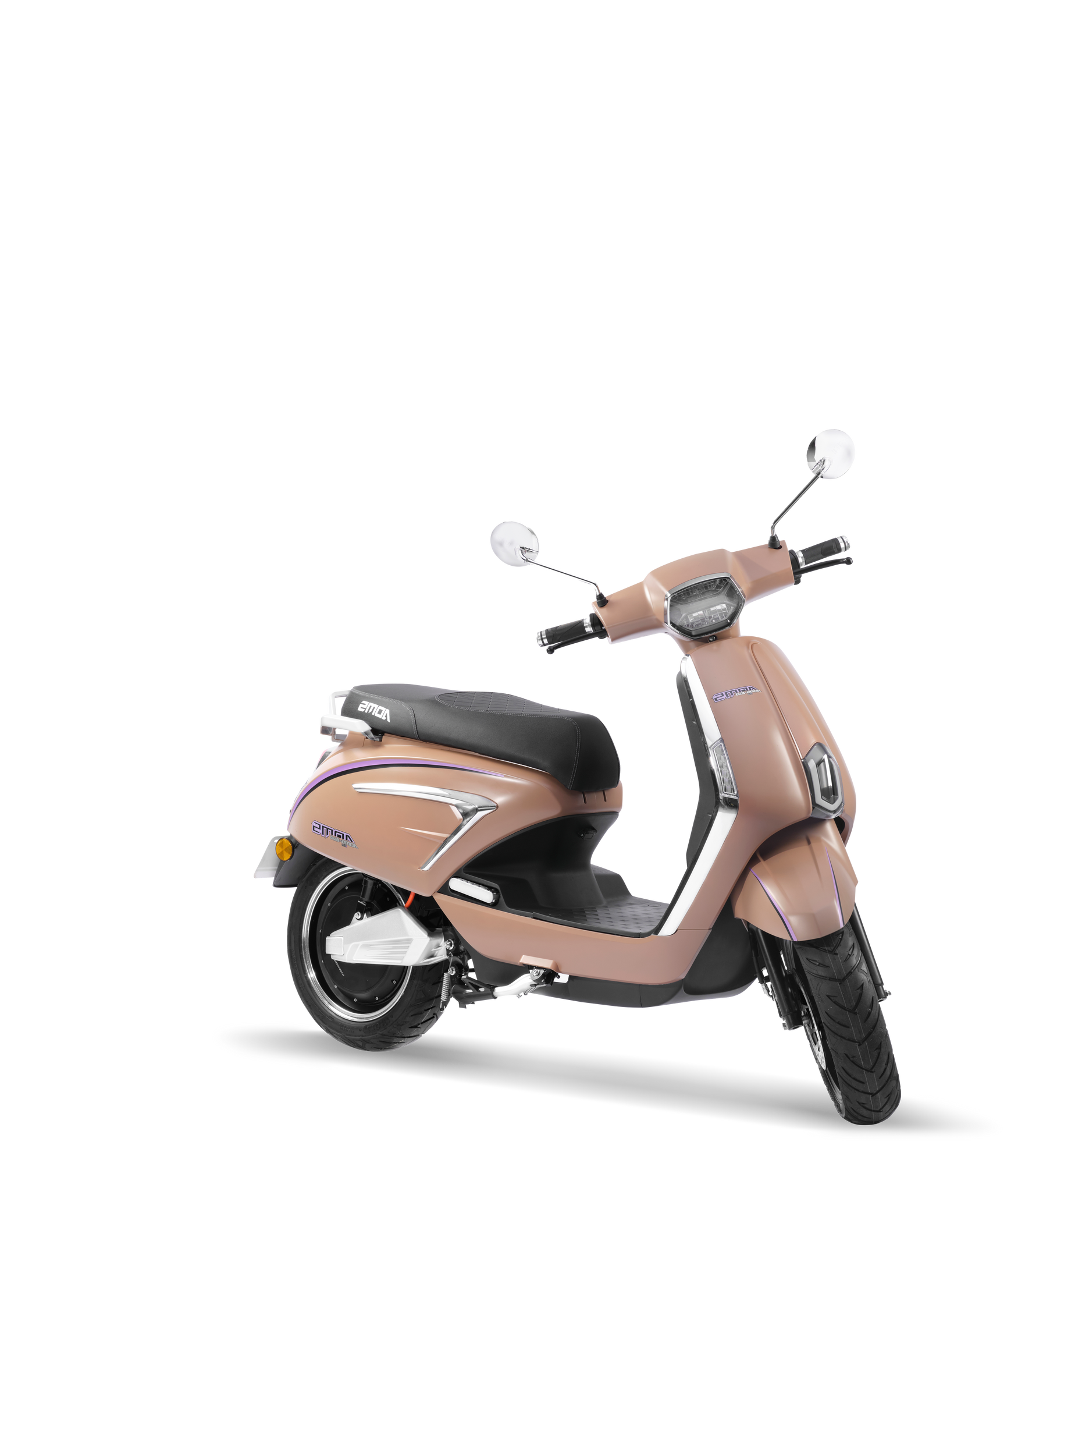
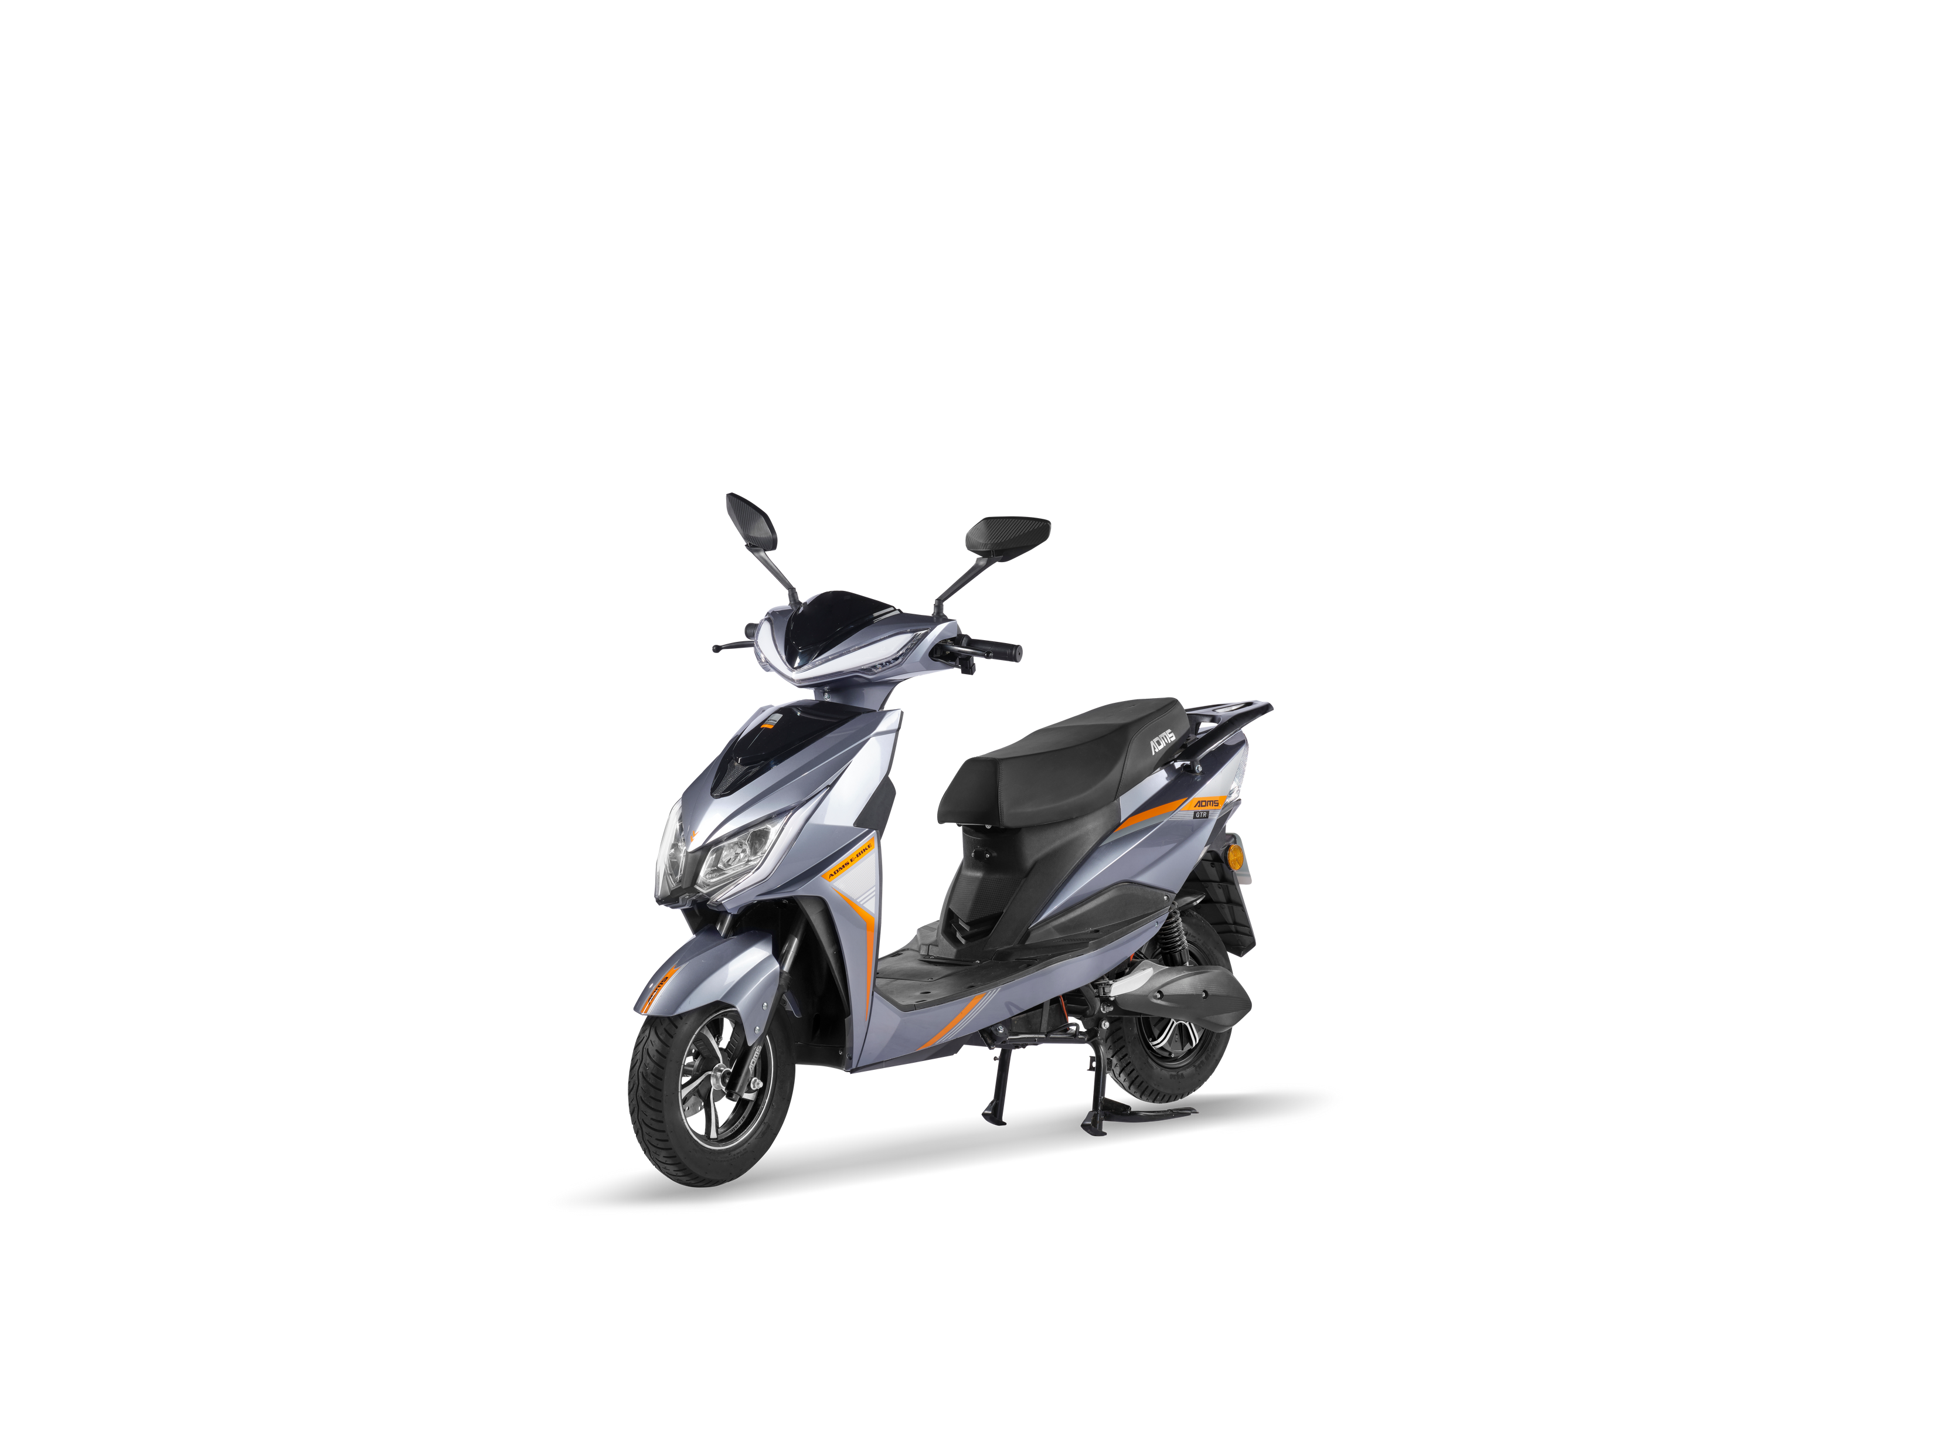
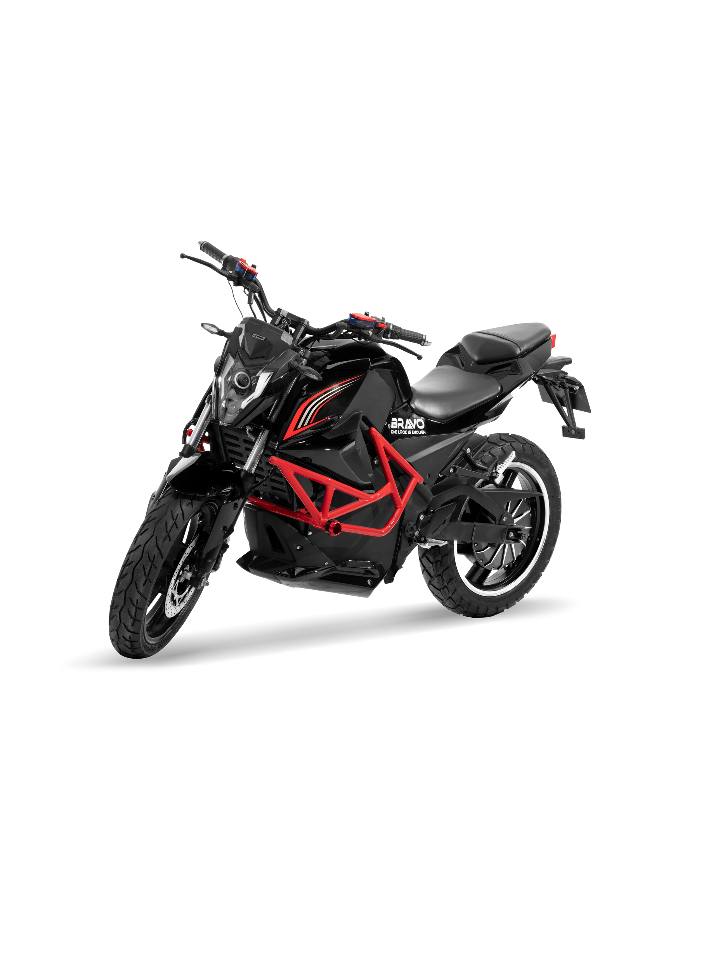
E V A
REGISTERED VEHICLES
G T R
BRAVO
₹1,35,000/-
₹79,800/-
RATED POWER: 2.5KW
PEAK POWER: 5KW
RANGE/CHARGE: 90/150KMS
BATTERY: 72V 40AH/72V 48AH
LOADING CAPACITY: 180KG
RATED POWER: 1000 W
PEAK POWER: 2000 W
RANGE/CHARGE: 60/100KMS
BATTERY: 48V 30AH/60V 36AH/60V 7AH*
LOADING CAPACITY: 180KG
₹1,85,000/-
RATED POWER: 3000 W
PEAK POWER: 6000 W
RANGE/CHARGE: 90/150KMS
BATTERY: 72V 45AH/72V 58AH
LOADING CAPACITY: 300KG
*PRICE DEPENDS UPON MARKET INFLATION AND BATTERY

Slide 11
6
650+
150+
MODERN MANUFACTRNG PLANTS
SHOWROOMS
-PAN INDIA
SKILLED
EMPLOYEE'S
OUR STRENGTH
A warm welcome to all the citizens of India from ADMS MARKETING PRIVATE LTD ,you all will be excited to know that our company ADMS MARKETING PRIVATE LTD , has extended its radius.Now we have 6 manufacturing plants , 4 in Dharwad (Karnataka) , 1 in Ajmer (RAJASTHAN) , and 1 in Hydrabad (TELANGANA)

Slide 12
JOIN US AND CREATE A SUCCESSFUL E-FUTURE
THERE ARE TWO WAYS OF PARTICIPATING IN THE EV-BUSINESS WITH US AS CUSTOMER – CUM – MARKETING DISTRIBUTORS
PURCHASE ANY EV-TWO WHEELER MODEL ABOVE RS.96,000/- *
RAISE A PURCHASE ORDER FOR EV BY PAYING RS.15,000/-**
OR
*Can also avail 3 Coupons worth of Rs. 4999/- each, that he/she sell the coupon or redeem it for themselves 1 Ccoupon each bike ( T&C APPLY)
**Can buy ADMS e vehicle with discount of Rs. 15000/- or can transfer the same Coupon to other individual & can also avail 3 Coupons worth of Rs. 4999/- each, that he/she sell the coupon or redeem it for themselves 1 Coupon each bike ( T&C APPLY)
GET AN OPPORTUNITY TO DO BUSINESS IN INDIA’S FASTEST GROWING INDUSTRY .
*T&C APPLY . ASK YOUR NEAREST MARKETING DISTRIBUTORS FOR DETAILS

Slide 13
OPPORTUNITY
REFER A CUSTOMER
REFER SOMEONE TO BUY AN ADMS ELECTRIC-TWO WHEELER MODEL ABOVE RS.96,000/- *
OR
REFER AN INTERESTED CUSTOMER TO BUY AN EV WITH P.O OF RS.15,000/-*
BENEFIT
BECOME A MARKETING DISTRIBUTORS & GET RS.5,000/-* COMMISSION
+
RS.1,500/-* TEAM BONUS
*T&C APPLY . ASK YOUR NEAREST MARKETING DISTRIBUTORS FOR DETAILS

Slide 14
MORE OPPORTUNITY
CREATE COMPETITON & EARN MORE
MAKE TWO GROUPS OF COMPETING
MARKETING DISTRIBUTORS & INCREASE YOUR PROFITS
GROUP A
GROUP B
PER PRODUCT PURCHASED * / ORDERED
RS.1,500/-* TEAM BONUS
PER PRODUCT PURCHASED * / ORDERED
RS.1,500/-* TEAM BONUS
THERE IS NO LIMIT TO WHERE YOU CAN GROW OR WHAT YOU CAN ACHIVE BY MAKING OTHERS AWARE OF YOUR BUSINESS
*T&C APPLY . ASK YOUR NEAREST MARKETING DISTRIBUTORS FOR DETAILS

Slide 15
30
e-Pay
20
DIGITAL PAYMENTS
WITH
GREAT PROFITS
10
0
2022
2023
2024
2025
2026
T&C APPLY

Slide 16
WHAT IS
ADMS E-PAY?
SIMPLE SPEAKING IT IS AN APP WHERE YOU CAN MAKE MULTI UTILITY PAYMENT AND CAN HELP OTHERS IN THE PROSESS MAKE PROFIT
HOW?
PROMOTE THE APP IN YOU GROUP FOR EVERY PAYMENT OR RECHARGE THAT THEY DO , YOU AND YOUR GROUP MEMBERS CAN AVAIL REWARDS

Slide 17
SERVICES PROVIDED BY ADMS E-PAY
MOBILE RECHARGE
D T H
ELECTRICITY
BILL
LANDLINE
BILL
GAS
BOOKING
WATER
BILL
GAME RECHARGE
FAST TAG RECHARGE
AND MANY MORE...
FOR PREMIUM MEMBERS (V D F)
ALL TYPES OF BANKING PRODUCTS
ACCOUNT OPENINGS ( SAVING / CURRENT ACCOUNT)
INSURANCE . . . . .AND MANY MORE.
*REFER YOUR VDF FOR INCOME CHART. T&C APPLY

Slide 18
WHAT ARE YOU WAITING FOR
ANOTHER DAY ANOTHER TIME
THE FUTURE IS INVENTED YESTERDAY
THOSE WHO SIEZE IT TODAY
HAVE A BETTER TOMORROW .
JOIN INDIA’S EV-REVOLUTION WITH ADMS TODAY
CONTACT YOUR NEAREST MARKETING DISTRIBUTORS FOR MORE DETAILS

Slide 19
MARKETING PVT LTD
(Advanced Distribution Management System)
THANK YOU
...SMART BIKE FOR SMART CITIZENS...
PLANT 2,000 TREES OR BUY AN ADMS EV-TWO WHEELER
www.admsebikes.in

